Slide 1
TIZEN
Native UI Builder
Fajri Koto fajri.fajri@samsung.com

Slide 2
TIZEN Overview
Web application
→ Easily build application using web native
→ C Programming
→ more advanced
→ includes Embedded system
enable to access device specific features, such as camera, GPS
Native application

Slide 3
UI Development on TIZEN
TAU (Tizen Advanced UI)
Web application
W3C / HTML5
User Interface
EFL (Enlightenment Foundation Library)
Native application
DALi (Dynamic Animation Library)

Slide 4
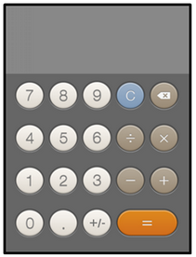
UI Development on TIZEN
Web application
Native application
EFL (Enlightenment Foundation Library)
- Lower memory, High performance
DALi (Dynamic Animation Library)
- Use OpenGL, requires GPU
- For virtual 3D
- Use this, if you are creating high-performance rich UI application
TAU (Tizen Advanced UI)
- Visual UI element, button, slider.
W3C / HTML5
- HTML & CSS

Slide 5
Tizen Native UI (EFL)
EFL is an open-source UI toolkit that provides a set of libraries that offer useful features to applications.
EFL covers a number of areas from UI component sets to data structures.
EFL is one of the Tizen native UI modules and is available in various Tizen profiles
UI Builder
Simplify the creation of Tizen Native Uis
User Interface
at EFL
EDC
Powerful theme feature to easily change your applications' UI

Slide 6
Native UI Builder
Tizen Native UI Builder is a graphical user interface builder tool that simplifies the creation of Tizen Native Uis
Easy because of Drag and Drop Method
Allows to arrange widgets using a drag-and-drop, called as
WYSIWYG (What You See Is What You Get)
The UI Builder supports a variety of UI widgets and various views:
- WYSIWYG editor and the Palette
- Properties view
- Outline view
- Navigation view
- Resources view

Slide 7
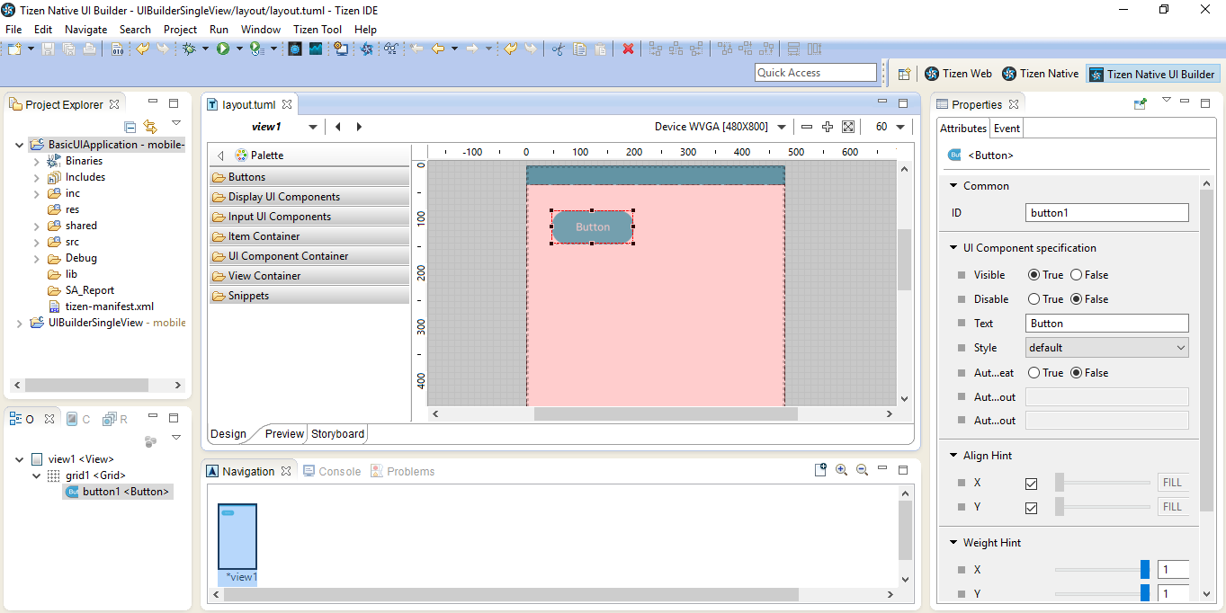
UI Builder in Tizen IDE
WYSIWYG window

Slide 8
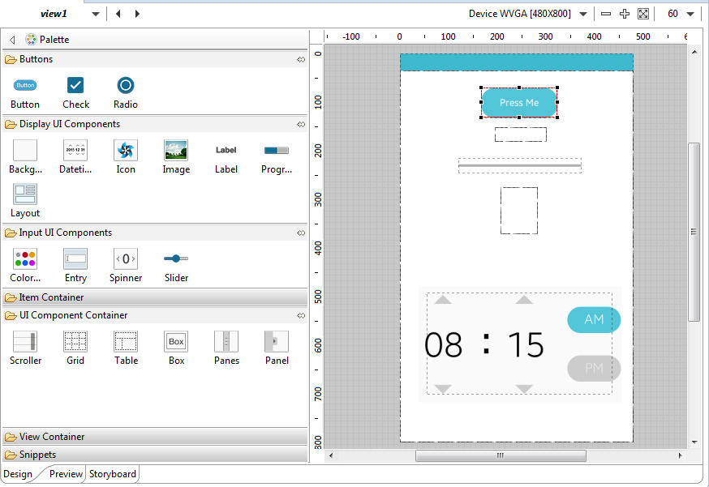
UI Builder in Tizen IDE

Slide 9
Application layout
Manual (Not Scalable)
Evas_object_move(), evas_object_resize()
Test
Game development
Not general
Container widget
Normally recommended
Use EDC Script
For advanced developers
Use Enventor tools

Slide 10
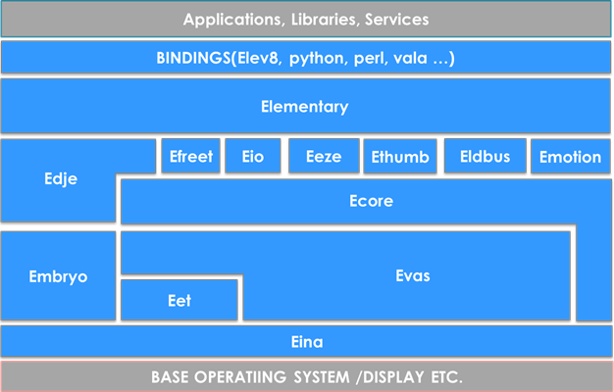
Widget in EFL
Elementary
About 75 Widgest
Types
- General: Bg, Button, Check, Entry, Label, List, Win, …
- Container: Box, Conformant, Grid, Layout, Panes, Scorrel, Table, ..

Slide 11
Widget in Tizen
Tizen supports about 36 widgets among those
Types:
- General
Bg, Button, Check, Colorselector, Ctxpopup, Datetime, Entry, Flip, GLView, Gengrid, Genlist, Icon, Image, Index, Label, List, Map, Mapbuf, Multibuttonentry, Notify, Panel, Panes, Photocam, Plug, Scroller, SegmentControl, Slider, Spinner, Toolbar, Win
https://developer.tizen.org/development/ui-practices/native-application/efl/ui-components
- Container
Conformant, Box, Grid, Layout, Naviframe, Table
https://developer.tizen.org/development/ui-practices/native-application/efl/ui-containers

Slide 12
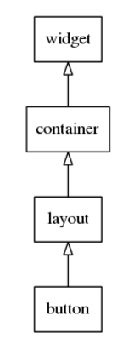
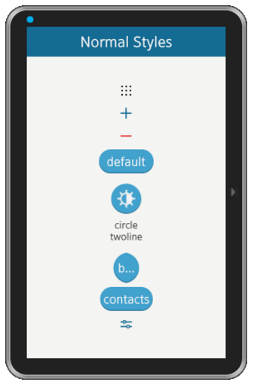
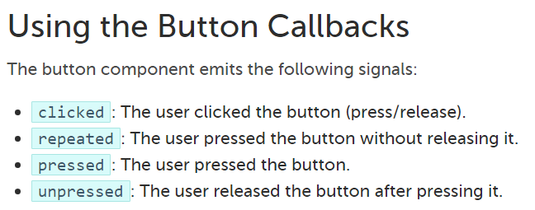
a. Some General Widgets (Mobile UI Components)
Button
Hierarchy

Slide 13
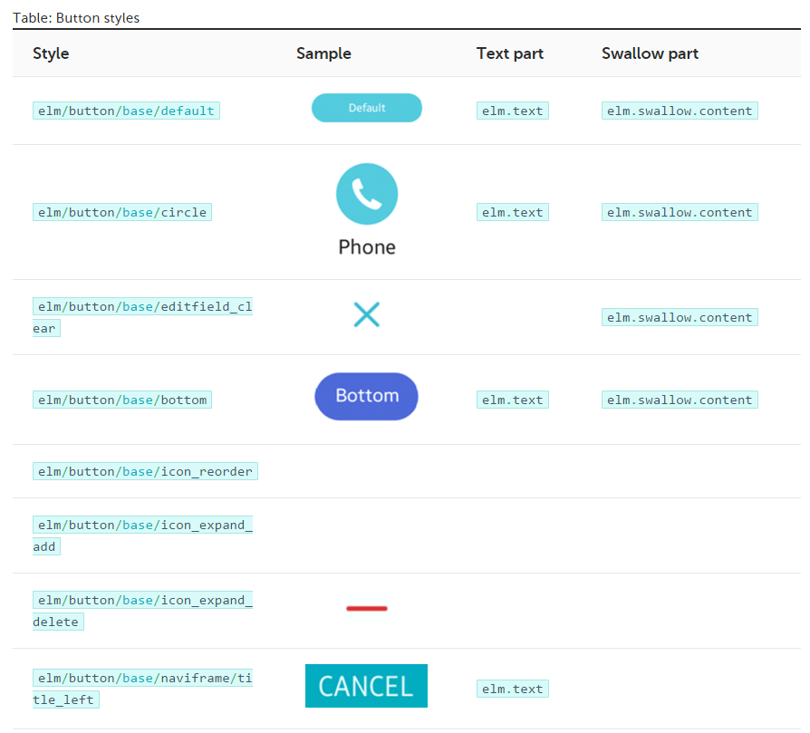
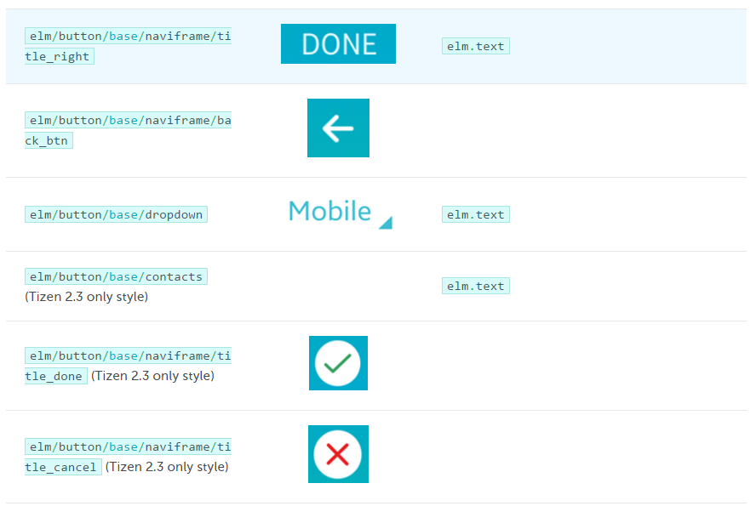
a. Some Mobile UI Components (General Widgets)
Button

Slide 14
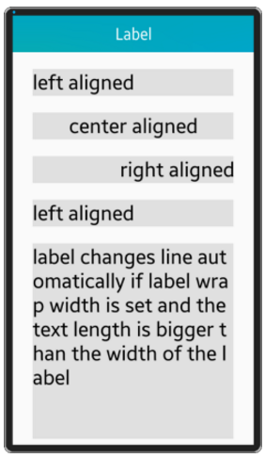
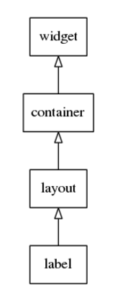
a. Some General Widgets (Mobile UI Components)
Label
Hierarchy

Slide 15
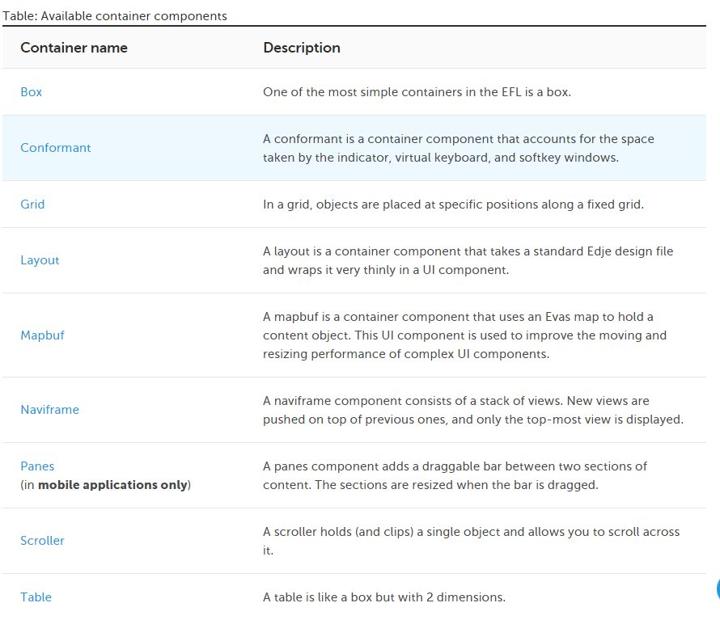
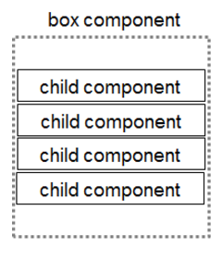
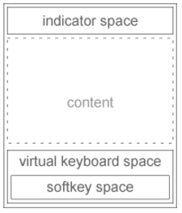
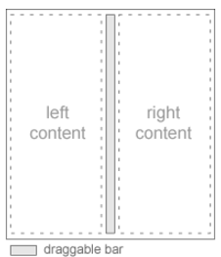
b. Container Components
Box
Conformant
Panes

Slide 16
Summary
Use EFL for UI
Use container widgets for your application layout
Open source platform Tizen covers multiple categories and devices
The Tizen Native Framework makes you write light and fast application
Tizen and EFL are open sources

Slide 17
Tizen
http://tizen.org
Mailing List
IRC
Git repositories
https://review.tizen.org/git/
Patches and Code Reviews
https://review.tizen.org/gerrit/
Wiki
https://wiki.tizen.org
Tizen Mobile Native App Proggramming

Slide 18
EFL
http://tizen.org
Mailing List
IRC
Git repositories
https://git.enlightenment.org
Patches and Code Reviews, Wiki, etc
https://phab.enlightenment.org/

Slide 19
THANK YOU
Next:
PROGRAMMING DEMO

